Slide 1
Top Performing Companies in CGI of Financial Year 2017

Slide 2
Companies Ranked Between 11 to 30 in
Non-Financial Sectors

Slide 3
Abdullah Al Othaim Markets Co.
Al Sorayai Trading and Industrial Group
Al Yamamah Steel Industries Co.
Alkhaleej Training and Education Co.
Altayyar Travel Group
Electrical Industries Co.
Etihad Etisalat Co.

Slide 4
Fawaz Abdulaziz Alhokair Co.
Hail Cement Co.
Jarir Marketing Co.
Lazurde Company for Jewelry
Makkah Construction and Development Co.
National Agricultural Development Co.

Slide 5
Rabigh Refining and Petrochemical Co.
Saudi Advanced Industries Co.
Saudi Airlines Catering Co.
Saudi Arabian Fertilizer Co.
Saudi Automotive Services Co.
Takween Advanced Industries Co.

Slide 6
Companies Ranked Between 7 to 12 in Financial Sector

Slide 7
Al Sagr Cooperative Insurance Co.
MetLife AIG ANB Cooperative Insurance Co.
National Commercial Bank
Riyad Bank
Saudi Arabian Cooperative Insurance Co.
Saudi Re for Cooperative Reinsurance Co.

Slide 8
Top 6 to 11 in Non-Financial Sectors

Slide 9

Rank 11
Middle East Paper Co.

Slide 10

Rank 10
Saudi Basic Industries Corp.

Slide 11

Rank 9
Saudi International Petrochemical Co.

Slide 12

Rank 8
Saudi Telecom Co.

Slide 13

Rank 7
Saudi Arabian Mining Co.

Slide 14
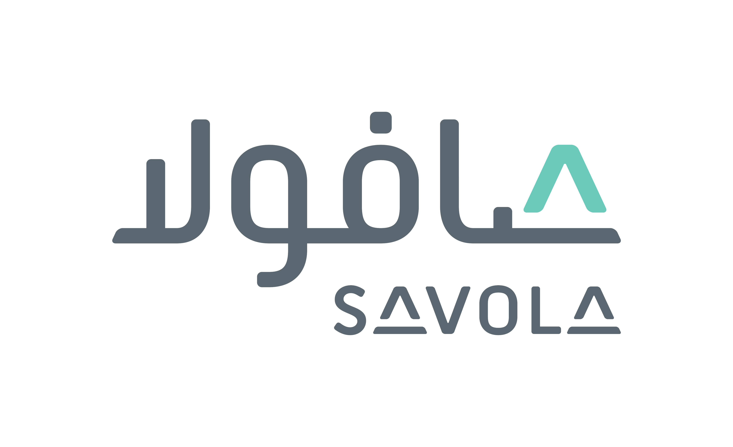
Rank 6
Savola Group

Slide 15
Top 4 to 6 in Financial Sector

Slide 16

Rank 6
Al Rajhi Bank

Slide 17

Rank 5
Aljazira Takaful Taawuni Co.

Slide 18

Rank 4
Alahli Takaful Co.

Slide 19
Top 5 in
Non-Financial Sectors

Slide 20

Fifth Ranked
Non-Financial Sectors
Saudi Ground Services Co.

Slide 21

Fourth Ranked
Non-Financial Sectors
Almarai Co.

Slide 22

Third Ranked
Non-Financial Sectors
Najran Cement Co.

Slide 23

Second Ranked
Non-Financial Sectors
Arabian Cement Co.

Slide 24
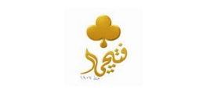
First Ranked
Non-Financial Sectors
Fitaihi Holding Group

Slide 25
Top 3 in Financial Sector

Slide 26

Third Ranked Financial Sector
The Company for Cooperative Insurance

Slide 27

Second Ranked Financial Sector
Arabian Shield Cooperative Insurance Co.

Slide 28
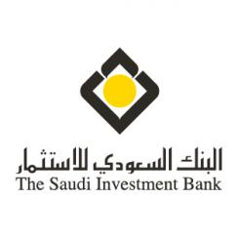
First Ranked Financial Sector
Saudi Investment Bank

